Slide 1
A Brief Introduction to Perl Regular Expressions in SAS® 9
Allen Zeng
May 21, 2013

Slide 2
Contents
Introduction
Creating a Regular Expression
Regular Expression Syntax
PRX(Perl Regular Expression)Function
PRXPARSE
PRXMATCH
PRXCHANGE
Others
Examples
References

Slide 3
Introduction
What is a Regular Expression
A pattern or A template that either matches or doesn’t match a given string in Perl
A way of describing one or more strings to match when you search a body of text
Function
Validate data
Replace text
Extract a substring from a string

Slide 4
Creating a Regular Expression
Components
A individual characters, sets of characters, ranges of characters, or choices between characters
Any combination of these components
Examples
PAREXEL
/PAREXEL/
'/PAREXEL/' or ''/PAREXEL/''
'/(\w+),\s(\w+)/'
'/\d{5}-\d{4}/'
4

Slide 5
Regular Expression Syntax
Special Characters
Character | Behavior | Example
/…/ | Starting and ending regex delimiters | /PAREXEL/
| | Indicates a choice between two or more items. | (z|f)ood matches "zood" or "food“.
() | Grouping, Marks the start and end of a subexpression. | A(\d) matches "A0" to "A9". The digit is saved for later use.
\num $num | Matches capture buffer num. | \1 or $1 matches capture buffer one.
. | Matches any single character except the newline character \n. | a.c matches "abc", "a1c", and "a-c“.
* | Matches the preceding character or subexpression zero or more times. | zo* matches "z" and "zoo“.
+ | Matches the preceding character or subexpression one or more times. | zo+ matches "zo" and "zoo", but not "z“.
5

Slide 6
Regular Expression Syntax
Special Characters
Character | Behavior | Example
[] | Marks the start and end of a bracket expression. | [1-4] matches "1", "2", "3", or "4".
{} | Marks the start and end of a quantifier expression. | a{2,3} matches "aa" and "aaa".
? | Matches the preceding character or subexpression zero or one time. Equivalent to {0,1}. | zo? matches "z" and "zo", but not "zoo". o+? matches a single "o" in "oooo", and o+ matches all "o"s.
^ | Matches the position at the start of the searched string. If the m (multiline search) character is included with the flags, ^ also matches the position following \n or \r. When used as the first character in a bracket expression, ^ negates the character set. | ^\d{3} matches 3 numeric digits at the start of the searched string. [^abc] matches any character except a, b, and c.
6

Slide 7
Regular Expression Syntax
Wildcards
Character | Behavior | Example
\d | Matches a digit character. Equivalent to [0-9]. | In the searched string "12 3", \d matches "1", 2", "3“.
\D | Matches a nondigit character. Equivalent to [^0-9]. | \D+ matches "abc" and " def" in "abc123 def".
\w | Matches any of the following characters: A-Z, a-z, 0-9, and underscore. Equivalent to [A-Za-z0-9_]. | In the searched string "The quick brown fox…", \w+ matches "The", "quick", "brown", and "fox".
\W | Matches any character except A-Z, a-z, 0-9, and underscore. Equivalent to [^A-Za-z0-9_]. | In the searched string "The quick brown fox…", \W+ matches "…" and all of the spaces.
7

Slide 8
Regular Expression Syntax
Nonprinting Characters
Character | Behavior | Equivalent to
\n | Newline character. | \x0a and \cJ
\r | Carriage-return character. | \x0d and \cM
\s | Any white-space character. This includes space, tab, and form feed. | [ \f\n\r\t\v]
\S | Any non–white space character. | [^ \f\n\r\t\v]
8

Slide 9
PRX(Perl Regular Expression)Function
Types of PRX functions
PRXPARSE
PRXMATCH
PRXCHANGE
PRXPOSN
Others
9

Slide 10
Function: PRXPARSE
Function
Compile Perl regular expression and return regular-expression-id to be used by other PRX functions.
Syntax
regular-expression-id=PRXPARSE (perl-regular-expression)
10

Slide 11
Function: PRXMATCH
Function
Searches for a pattern match and returns the position at which the pattern is found
Syntax
PRXMATCH (regular-expression-id|perl-regular-expression, source)
11

Slide 12
Function: PRXCHANGE
Function
Performs a pattern-matching replacement
Syntax
PRXCHANGE(regular-expression-id|perl-regular-expression, times, source)
12

Slide 13
Example: Basic Example
data _null_;
string='Hello world!';
reID=prxparse('/world/');
pos=prxmatch(reID,string);
/* pos=prxmatch('/world/',string); */
put pos=;
txt=prxchange('s/world/planet/',-1, string);
put txt=;
run;
Output:
pos=7
txt=Hello planet!
13

Slide 14
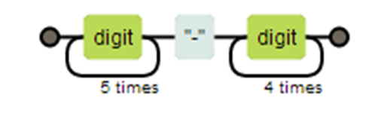
Example: Data Validation
data ZipCodes;
input name: $16. zip:$10. @@;
datalines;
Johnathan 32523-2343 Seth 85030 Kim 39204 Samuel 93849-3843
;
data ZipPlus4;
set ZipCodes;
where prxmatch('/\d{5}-\d{4}/', zip);
run;
Output:
Obs name zip
1 Johnathan 32523-2343
2 Samuel 93849-3843
14

Slide 15
Example: Search and Replace #1
data _null_;
string='Hello world world!';
/* Replace the second word */
txt1=prxchange('s/world/planet/',1, string);
/* Replace the last word */
txt2=prxchange('s/(.+)world/$1planet/',-1, string);
put txt1=/txt2=;
run;
Output:
txt1=Hello planet world!
txt2=Hello world planet!
15

Slide 16

Example: Search and Replace #2
data reversed_names;
input name & $32. @@;
datalines;
Jones, Fred Kavich, Kate Turley, Ron
;
data names;
set reversed_names;
name = prxchange('s/(\w+),\s(\w+)/$2 $1/',-1, name);
run;
Output:
Obs name
1 Fred Jones
2 Kate Kavich
3 Ron Turley
16

Slide 17
Example: Extract a substring from a string
data _null_;
string='Table 1.1 Subject Disposition including Screening Failures - All Screened Subjects 3';
title1=substr(compbl(string),length(scan(string,1))+length(scan(string,2,' '))+3,length(compbl(string))-length(scan(string,-1))-(length(scan(string,1))+length(scan(string,2,' '))+1)-1);
title2=scan(string,3,' ');
do i=4 to countw(string)-1;
title2=catx(' ',title2,scan(string,i,' '));
end;
put title1=;
run;
Output:
title1= Subject Disposition including Screening Failures - All Screened Subjects
17

Slide 18
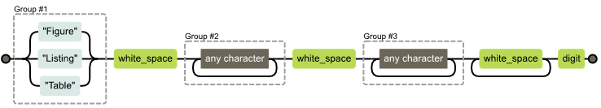
Example: Extract a substring from a string
data _null_;
string='Table 1.1 Subject Disposition including Screening Failures - All Screened Subjects 3'; title3=prxchange("s/(Figure|Listing|Table)\s(.+?)\s(.+?)\s+\d/$3/",-1,string);
put title3=;
run;
Output:
title3=Subject Disposition including Screening Failures - All Screened Subjects
18

Slide 19
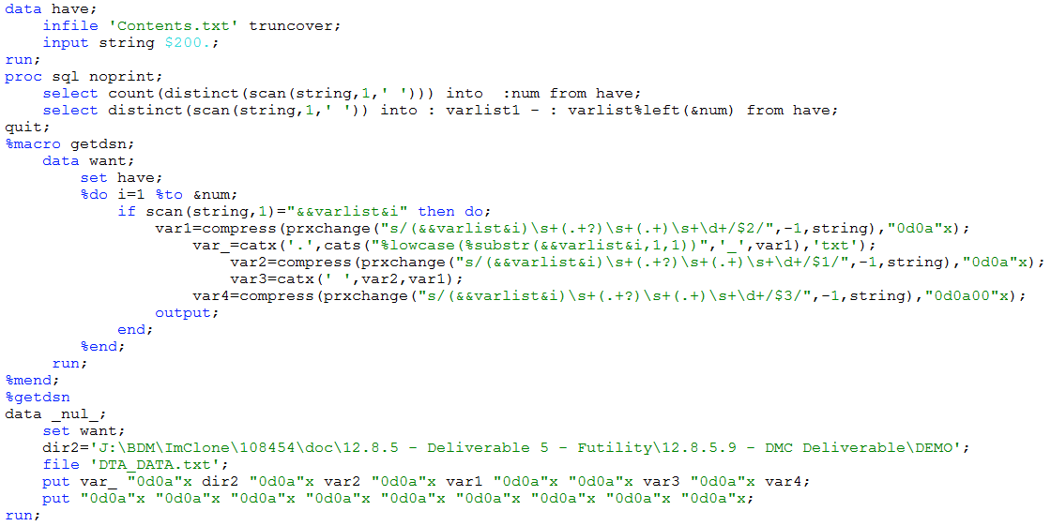
Example: Extract a substring from a string
19

Slide 20
References
http://www.regexper.com/
http://support.sas.com/documentation/cdl/en/lrdict/64316/HTML/default/viewer.htm#a003288497.htm
http://support.sas.com/documentation/cdl/en/lrdict/64316/HTML/default/viewer.htm#a002295977.htm
http://support.sas.com/documentation/cdl/en/lrdict/64316/HTML/default/viewer.htm#a002296115.htm
http://support.sas.com/documentation/cdl/en/lrdict/64316/HTML/default/viewer.htm#a002601591.htm
http://www2.sas.com/proceedings/sugi29/265-29.pdf
http://support.sas.com/rnd/base/datastep/perl_regexp/regexp-tip-sheet.pdf
http://www.wuss.org/proceedings09/09WUSSProceedings/papers/tut/TUT-Cassell.pdf

Slide 21
Thanks !

